Slide 1

Gaurav
Garuddwar
Driving E-Mobility adoption
And solving the challenges that come for this economy.

Slide 2

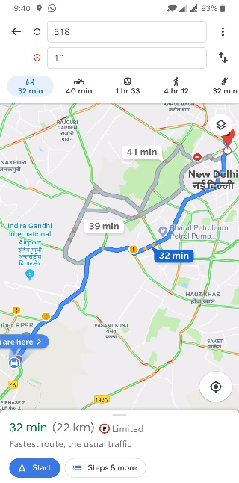
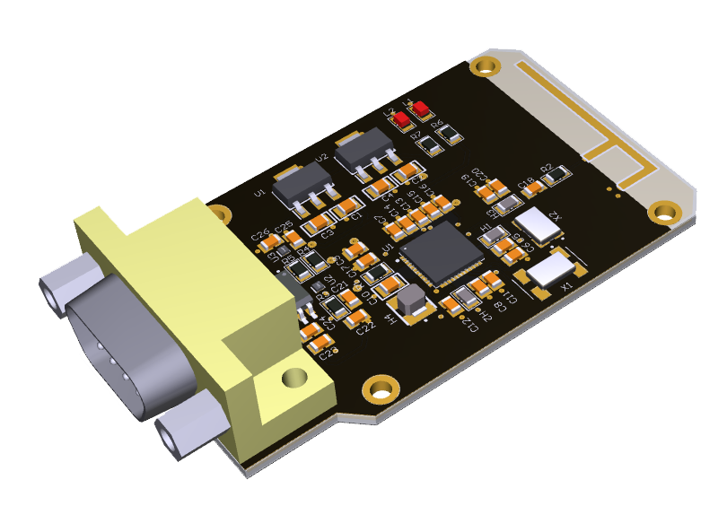

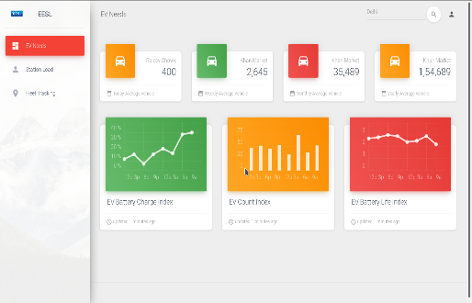
Gaurav
Garuddwar
Garud
Gaurav
Dwar
Technology Solution

Slide 3
Garud
Low cost device with CAN Protocol support
To access battery management system data of EV
In Realtime

Slide 4
Garud
Time series data
Data from BMS
Data from BMS
Driver ID (to identify BMS meta data & Car model)
Input Current
Input Voltage
Temperature
BMS load
Data from Filter for BMS without SoC Tracking
SoC Estimation
(To generate filter data)
Calibration data
State of charge (from Voltage, Input Current, Temperature of battery)
State of Life (Rate of change of SoC with BMS load parameters & Datasheet ground truth and calibration error)
Calibration delta (rate of change of calibration error)
Log of charge activity

Slide 5

Gaurav
Cross platform App
To access data from device
To access device location
To get user information
Push them all to server
Display analytics
Give battery charge info
Give battery life info
Navigation to EV Stations
And more …
Automatic pairing with Garud

Slide 6
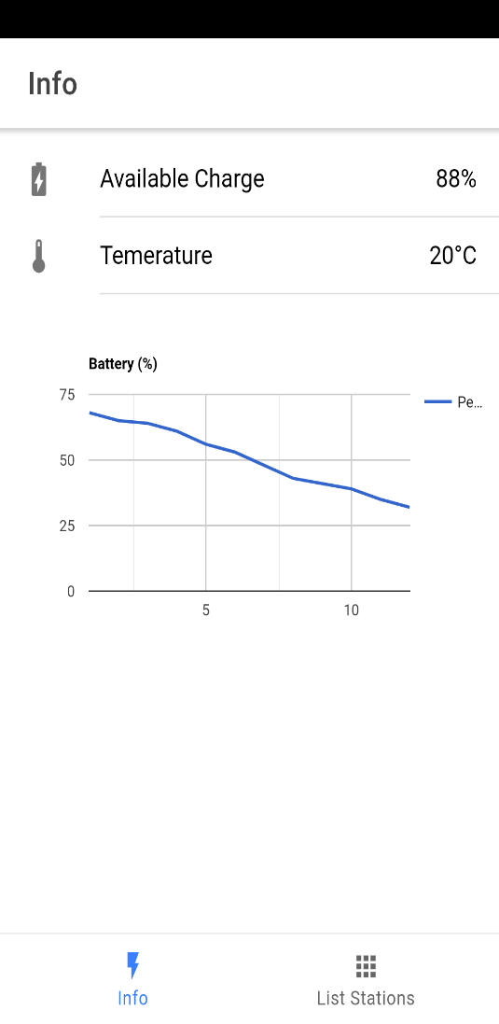
Gaurav

Slide 7
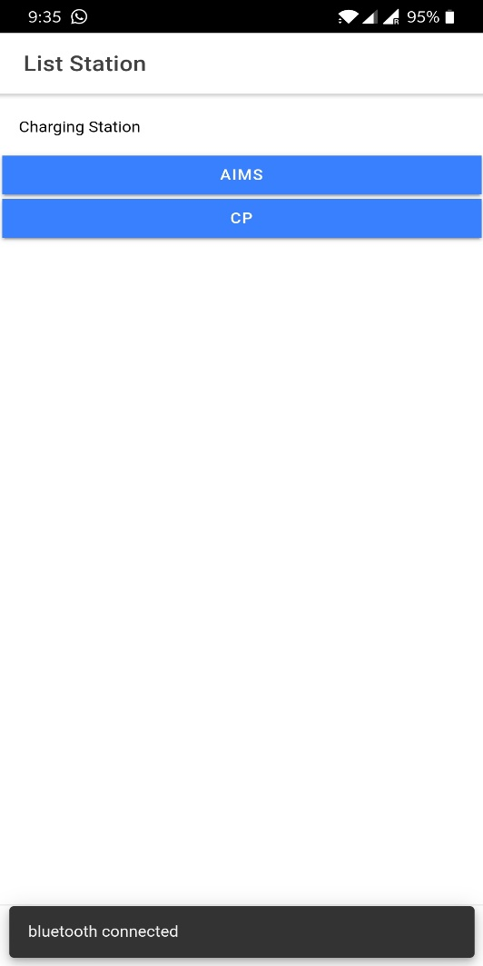
Gaurav

Slide 8
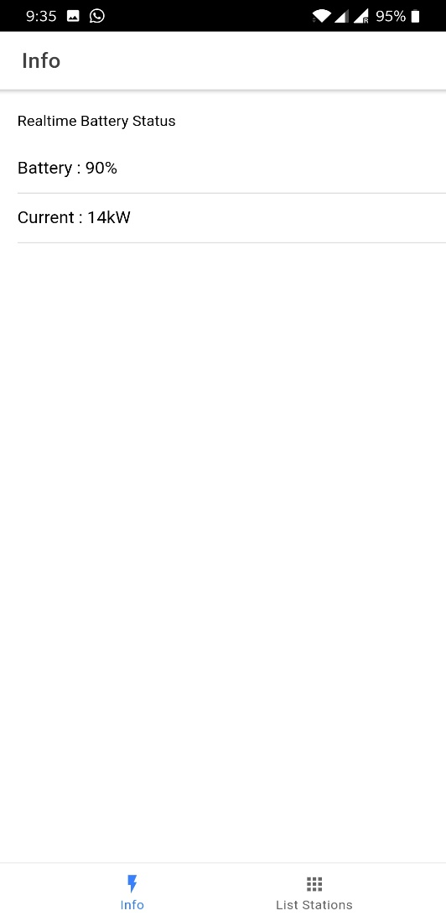
Gaurav

Slide 9


Nationwide fleet of EV

Slide 10


Dwar
To drive analytics
Fleet monitoring
EV station placement
Position (Lat, Long)
Capacity & Distribution
Battery waste/lifecycle management
Dashboards & APIs for
EESL
Charging Stations
Analysts & Third Parties

Slide 11

Dwar

Slide 12
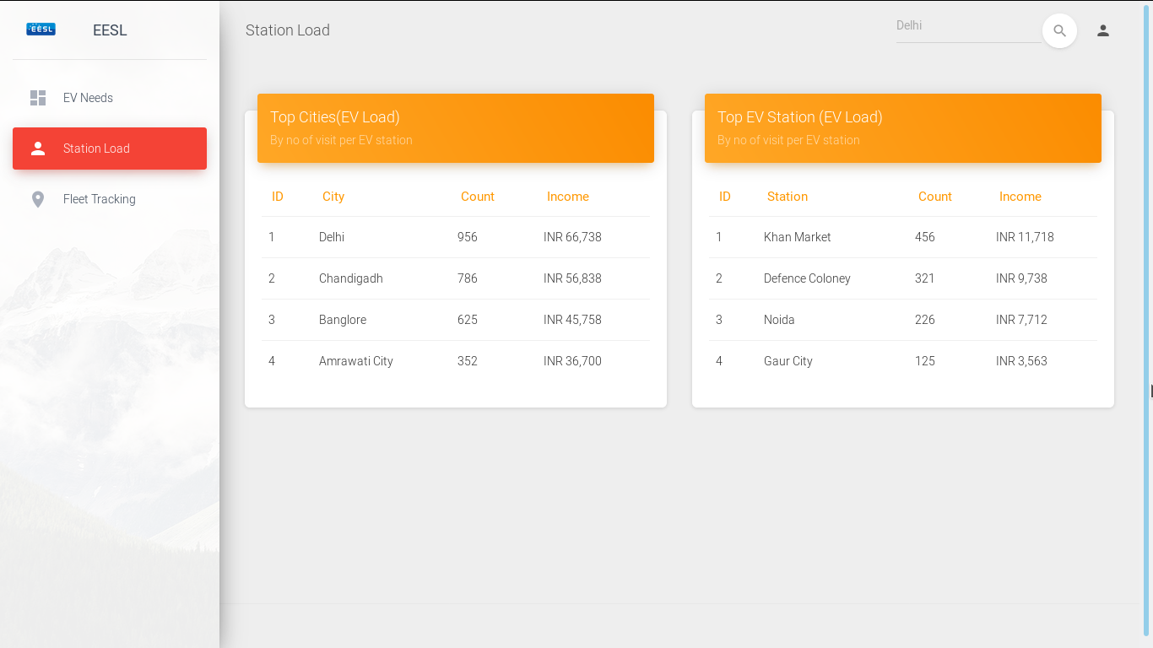
Dwar

Slide 13
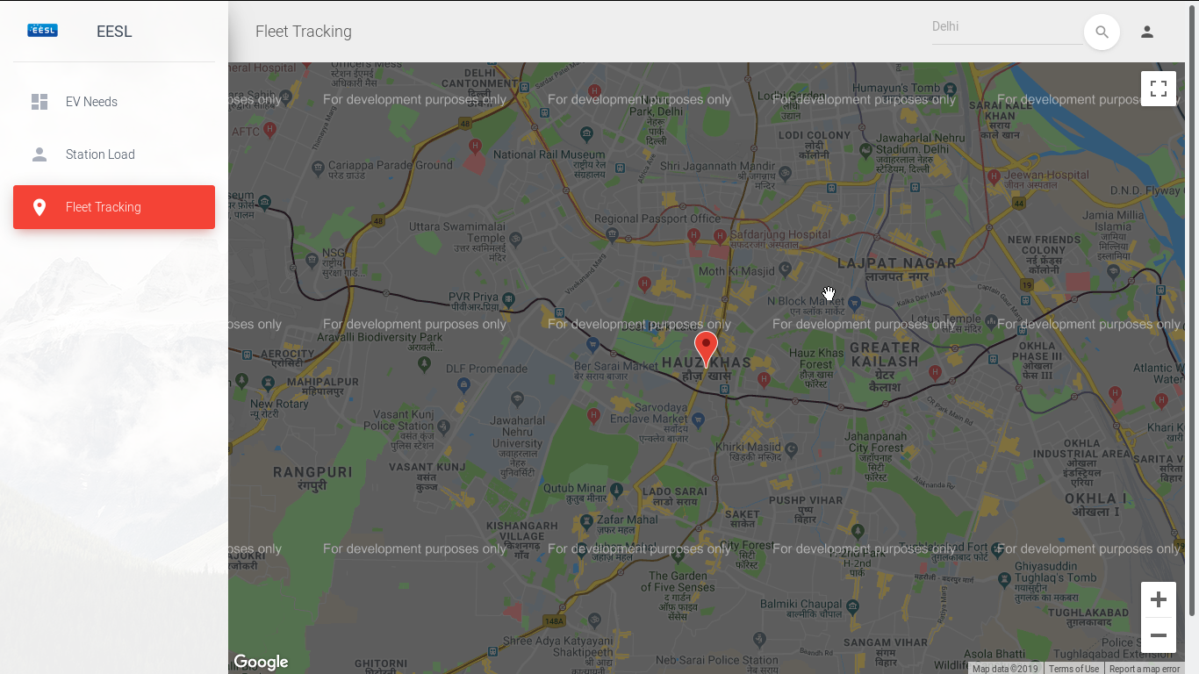
Dwar

Slide 14

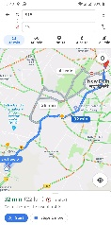



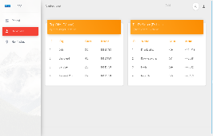
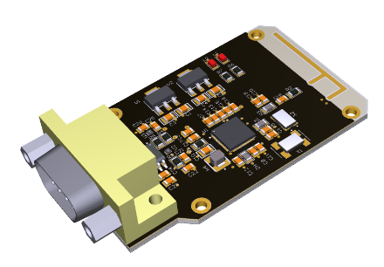


Gaurav
Insights
Analytics Engine
Display analytics
Give battery charge info
Give battery life info
Navigation to EV Stations
And more …
Dwar
Insights
Fleet monitoring
EV station placement
Position (Lat, Long)
Capacity & Distribution
Battery waste/lifecycle management
Garud
EVs
Data

Slide 15
Gaurav
Insights
Analytics Engine
Display analytics
Give battery charge info
Give battery life info
Navigation to EV Stations
And more …
Dwar
Insights
Fleet monitoring
EV station placement
Position (Lat, Long)
Capacity & Distribution
Battery waste/lifecycle management
Garud
EVs
Data

Slide 16
Gaurav
Insights
Analytics Engine
Display analytics
Give battery charge info
Give battery life info
Navigation to EV Stations
And more …
Dwar
Insights
Fleet monitoring
EV station placement
Position (Lat, Long)
Capacity & Distribution
Battery waste/lifecycle management
Garud
EVs
Data

Slide 17
Gaurav
Insights
Analytics Engine
Display analytics
Give battery charge info
Give battery life info
Navigation to EV Stations
And more …
Dwar
Insights
Fleet monitoring
EV station placement
Position (Lat, Long)
Capacity & Distribution
Battery waste/lifecycle management
Garud
EVs
Data

Slide 18
Gaurav
Insights
Analytics Engine
Display analytics
Give battery charge info
Give battery life info
Navigation to EV Stations
And more …
Dwar
Insights
Fleet monitoring
EV station placement
Position (Lat, Long)
Capacity & Distribution
Battery waste/lifecycle management
Garud
EVs
Data

Slide 19

Cross platform App
To access data from device
To access device location
To get user information
Push them all to server
Display analytics
Give battery charge info
Give battery life info
Navigation to EV Stations
And more …

Slide 20
Reward points for app usage
Exchangeable at EV Complex facilities
Exchangeable for replacement of battery at discounts
Incentivizing usage of data sharing policy
Incentivizing waste aggregation at EV complex
This can be better utilized for battery waste monitoring and mitigation through data.
Essentially transforming EV Complex in a complete solution.

Slide 21
Gaurav
Garuddwar
Technology Solution - Estimates

Slide 22
Gaurav
Insights
Analytics Engine
Display analytics
Give battery charge info
Give battery life info
Navigation to EV Stations
And more …
Dwar
Insights
Fleet monitoring
EV station placement
Position (Lat, Long)
Capacity & Distribution
Battery waste/lifecycle management
Garud
EVs
Data

Slide 23
Gaurav
Insights
Analytics Engine
The move targets the two highest selling categories in the Indian automotive market,
together counting to a total of over 2 crore units annually.
Source
Display analytics
Give battery charge info
Give battery life info
Navigation to EV Stations
And more …
Dwar
Insights
Fleet monitoring
EV station placement
Position (Lat, Long)
Capacity & Distribution
Battery waste/lifecycle management
Garud
EVs
Data

Slide 24
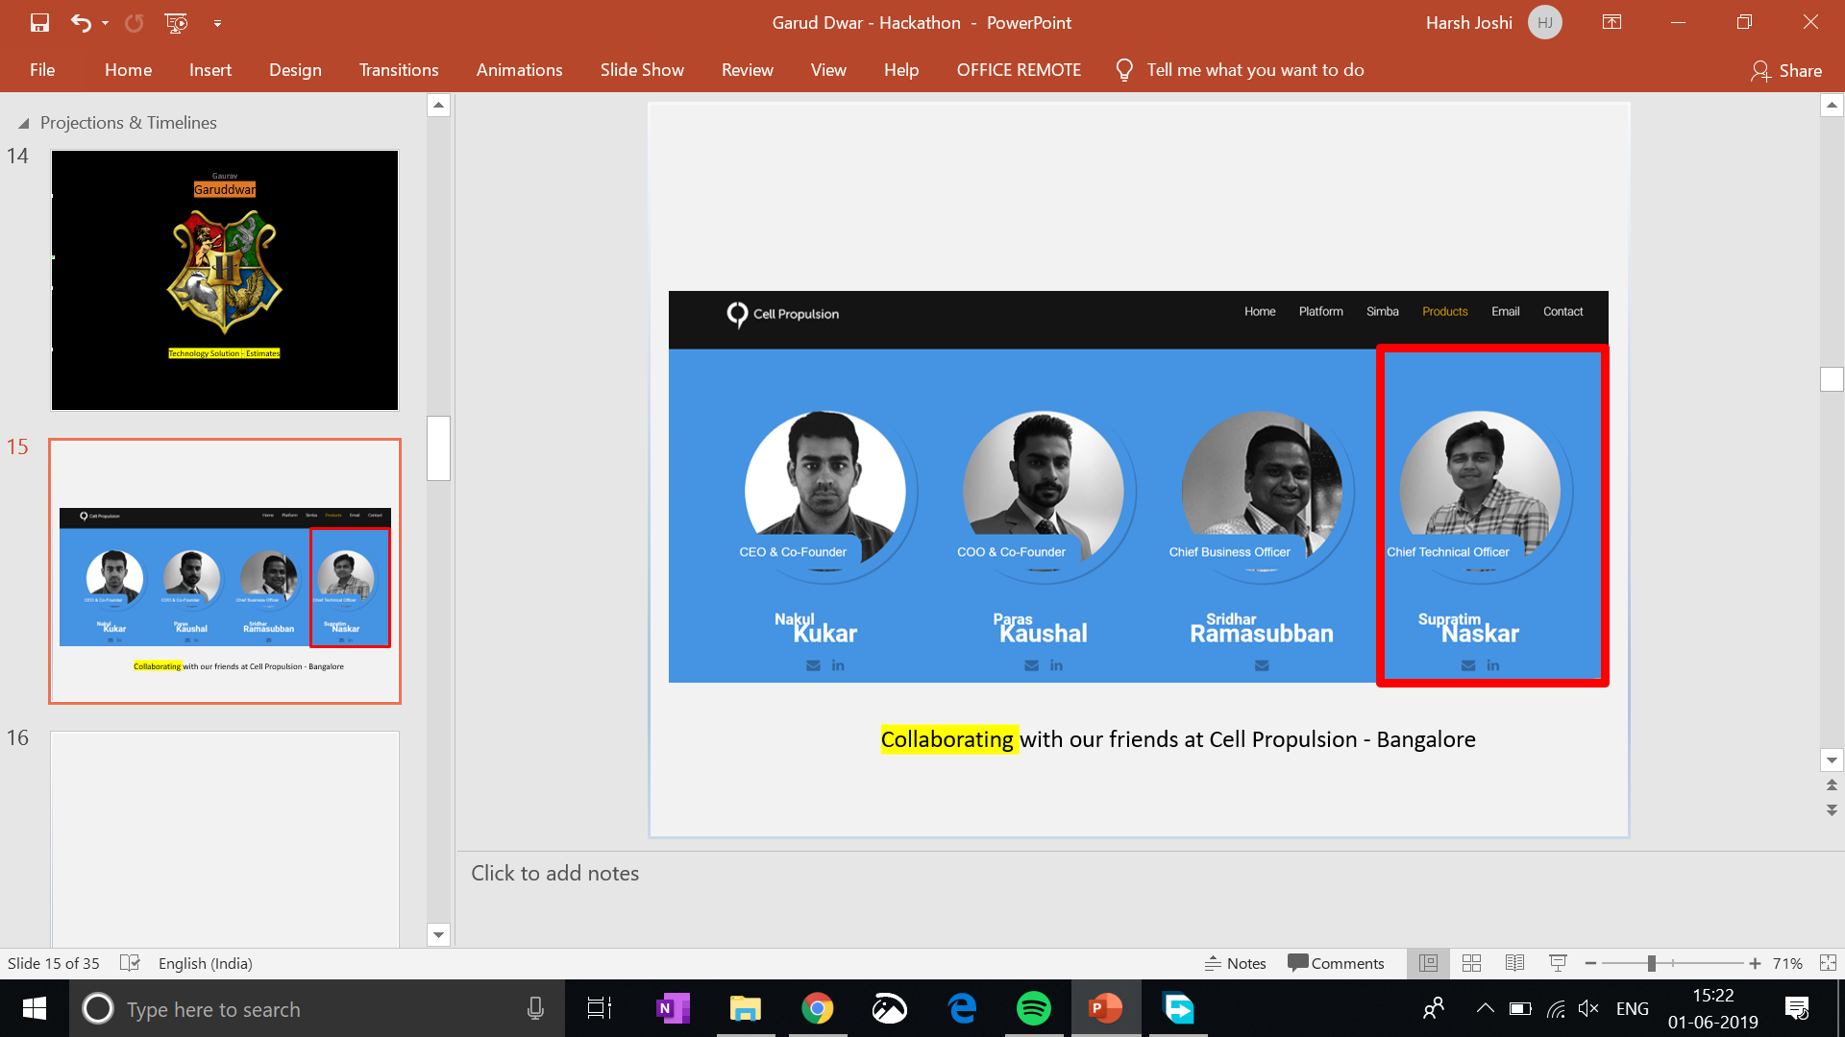
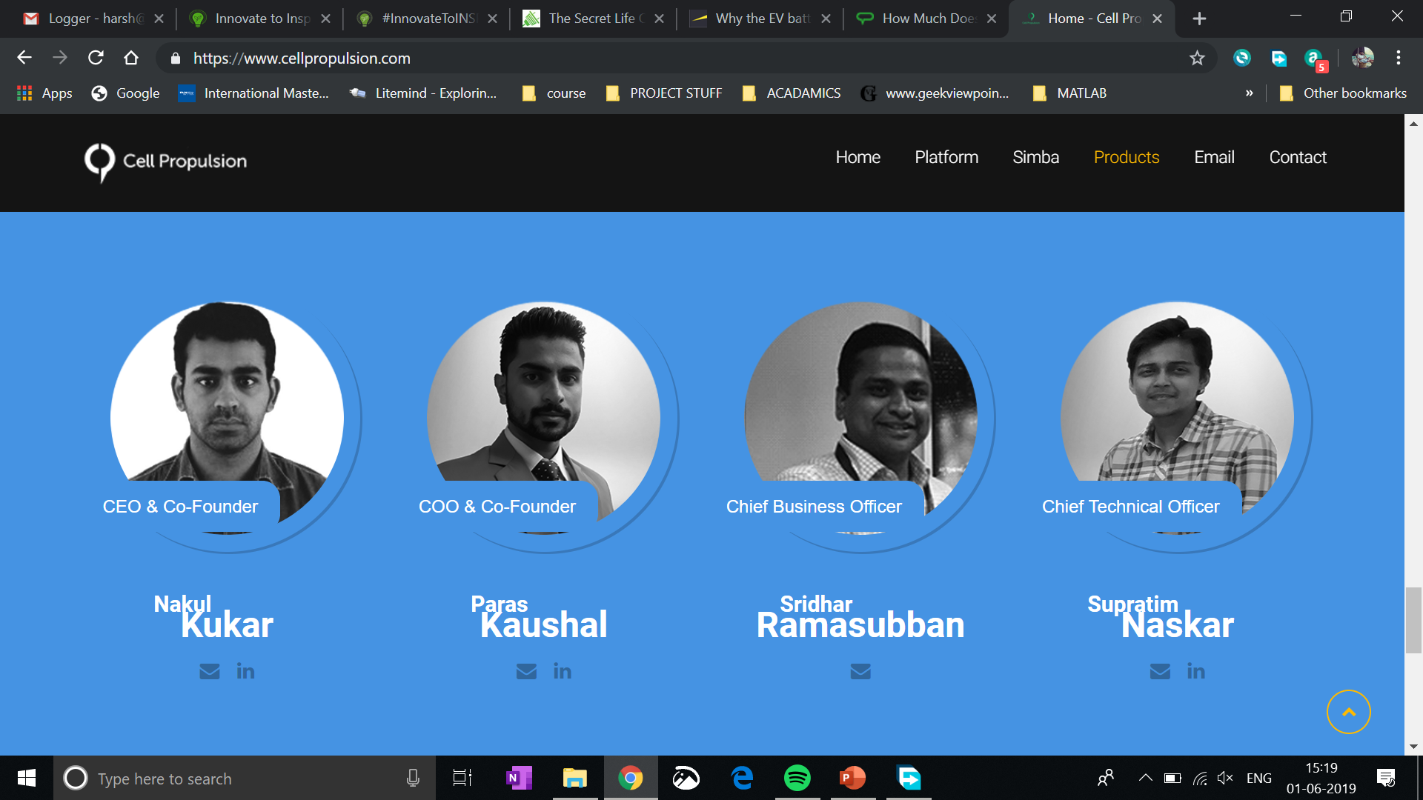
Collaborating with our friends at Cell Propulsion - Bangalore

Slide 25
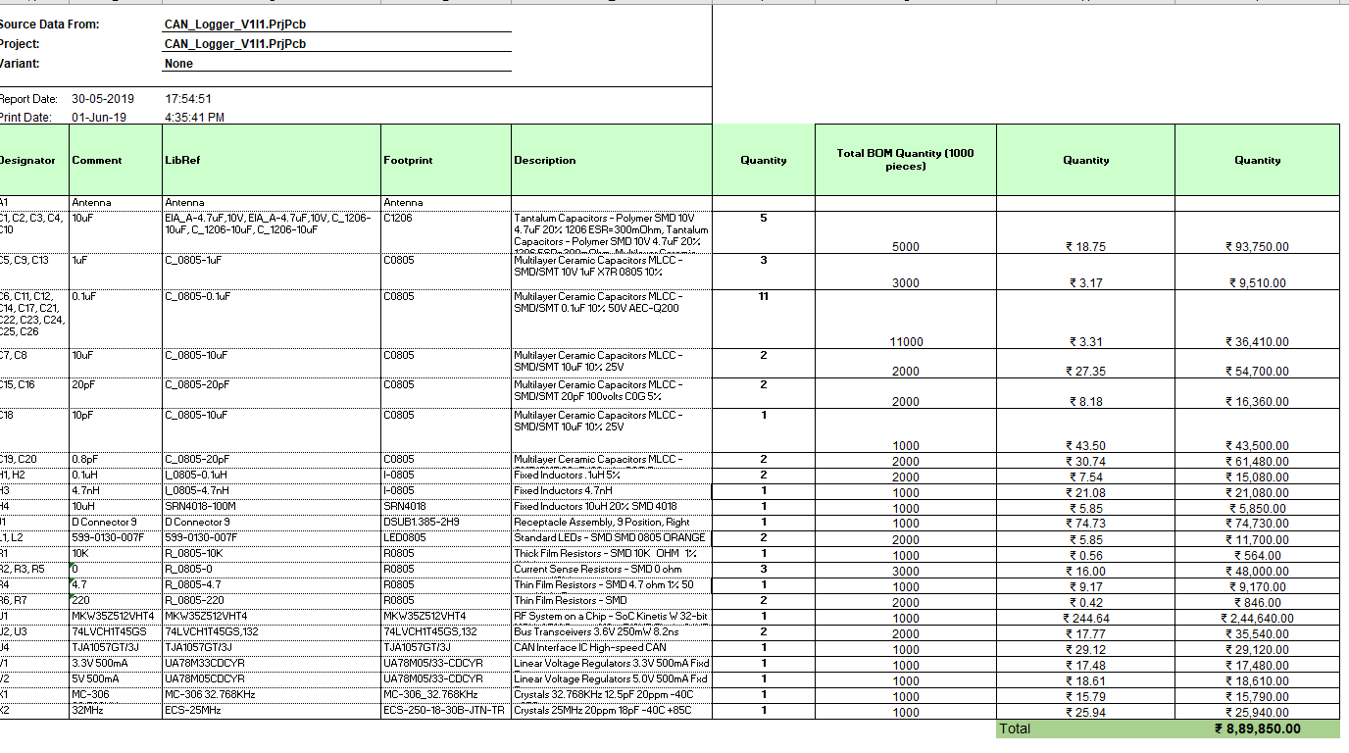
Prototype cost 1000 pieces to start field trials = 890/- INR per piece
Production deadline starting today = 12th of July 2019
Market Ready given 3 months of field trials = 2nd of November 2019

Slide 26
Gaurav
Insights
USP to drive EV mobility sustainably
Analytics Engine
Display analytics
Give battery charge info
Give battery life info
Navigation to EV Stations
And more …
Dwar
Insights
Fleet monitoring
EV station placement
Position (Lat, Long)
Capacity & Distribution
Battery waste/lifecycle management
Garud
EVs
Data

Slide 27

Market Ready given 3 months of field trials = 2nd of November 2019

Slide 28
Market Ready given 3 months of field trials = 2nd of November 2019

Slide 29
Gaurav
Garuddwar
Business Solution

Slide 30
Gaurav
Insights
Analytics Engine
Option A : Strategic tie ups with EV distributors, manufacturers & BMS manufacturers to avail market penetration
Display analytics
Give battery charge info
Give battery life info
Navigation to EV Stations
And more …
Dwar
Insights
Fleet monitoring
EV station placement
Position (Lat, Long)
Capacity & Distribution
Battery waste/lifecycle management
Garud
EVs
Data

Slide 31
Gaurav
Insights
Analytics Engine
Option B : To sell it as standalone product. App reward model to incentivize the purchase of device.
Display analytics
Give battery charge info
Give battery life info
Navigation to EV Stations
And more …
Dwar
Insights
Fleet monitoring
EV station placement
Position (Lat, Long)
Capacity & Distribution
Battery waste/lifecycle management
Garud
EVs
Data

Slide 32
Gaurav
Insights
USP to drive EV mobility sustainably
Analytics Engine
Display analytics
Give battery charge info
Give battery life info
Navigation to EV Stations
And more …
Dwar
Insights
Fleet monitoring
EV station placement
Position (Lat, Long)
Capacity & Distribution
Battery waste/lifecycle management
Garud
EVs
Data
Option A : App based reward points, for exchange at EV complex for:
Facilities at Complex
Battery Replacements
Maintenance
Premiere rush in slot booking

Slide 33
Gaurav
Insights
USP to drive EV mobility sustainably
Analytics Engine
Display analytics
Give battery charge info
Give battery life info
Navigation to EV Stations
And more …
Dwar
Insights
Fleet monitoring
EV station placement
Position (Lat, Long)
Capacity & Distribution
Battery waste/lifecycle management
Garud
EVs
Data
Option B : Monetization avenue for utilizing our APIs & Datasets for analysts, third party developers and businesses; built around booming EV economy space in India.

Slide 34
Gaurav
Insights
USP to drive EV mobility sustainably
Analytics Engine
Display analytics
Give battery charge info
Give battery life info
Navigation to EV Stations
And more …
Dwar
Insights
Fleet monitoring
EV station placement
Position (Lat, Long)
Capacity & Distribution
Battery waste/lifecycle management
Garud
EVs
Data
Opportunity A : Focused and aggregated fleet analytics for EESL & third parties to plan EV Station commissioning & Planning

Slide 35
Gaurav
Insights
USP to drive EV mobility sustainably
Analytics Engine
Display analytics
Give battery charge info
Give battery life info
Navigation to EV Stations
And more …
Dwar
Insights
Fleet monitoring
EV station placement
Position (Lat, Long)
Capacity & Distribution
Battery waste/lifecycle management
Garud
EVs
Data
Opportunity B : By not charging developers for accessing data, they can strategically drive more entry comfort for App ecosystem, around the offering.

Slide 36
Gaurav
Garuddwar
Scalability Solution

Slide 37
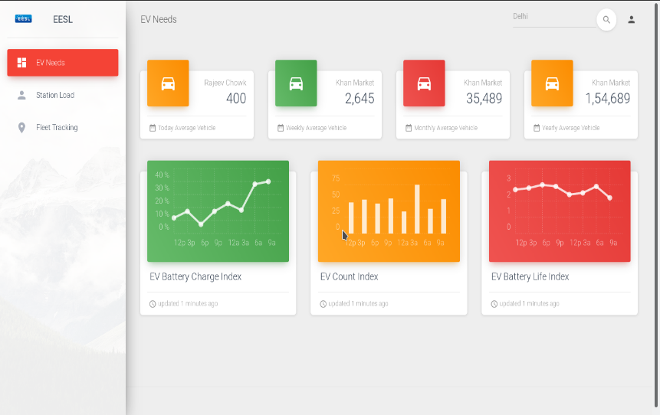
To drive analytics
Fleet monitoring
EV station placement
Position (Lat, Long)
Capacity & Distribution
Battery waste/lifecycle management
Dashboards & APIs for
EESL
Charging Stations
Analysts & Third Parties

Slide 38


Android OS
Android SDK
In the first quarter of 2016, about 84 percent of smartphones sold to end users used Android as its operating system. Android is expected to maintain its smartphone market share of about 85 percent up to 2020, while Apple's iOS is projected to account for 15 percent.
https://www.statista.com/statistics/236027/global-smartphone-os-market-share-of-android/
System Applications
GUI
Utility Applications

Slide 39
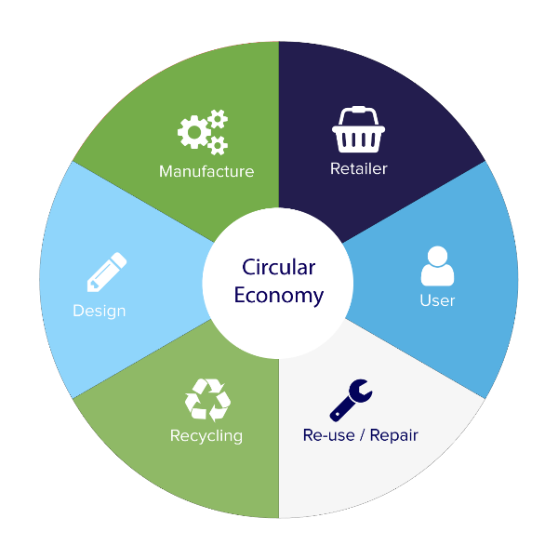

Garud
Gaurav
Dwar

Slide 40
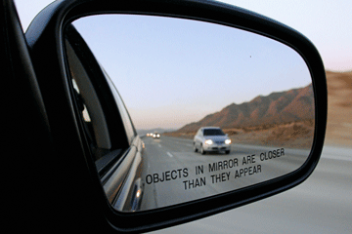
It’s about time we have a sustainable & circular economy.

Slide 41

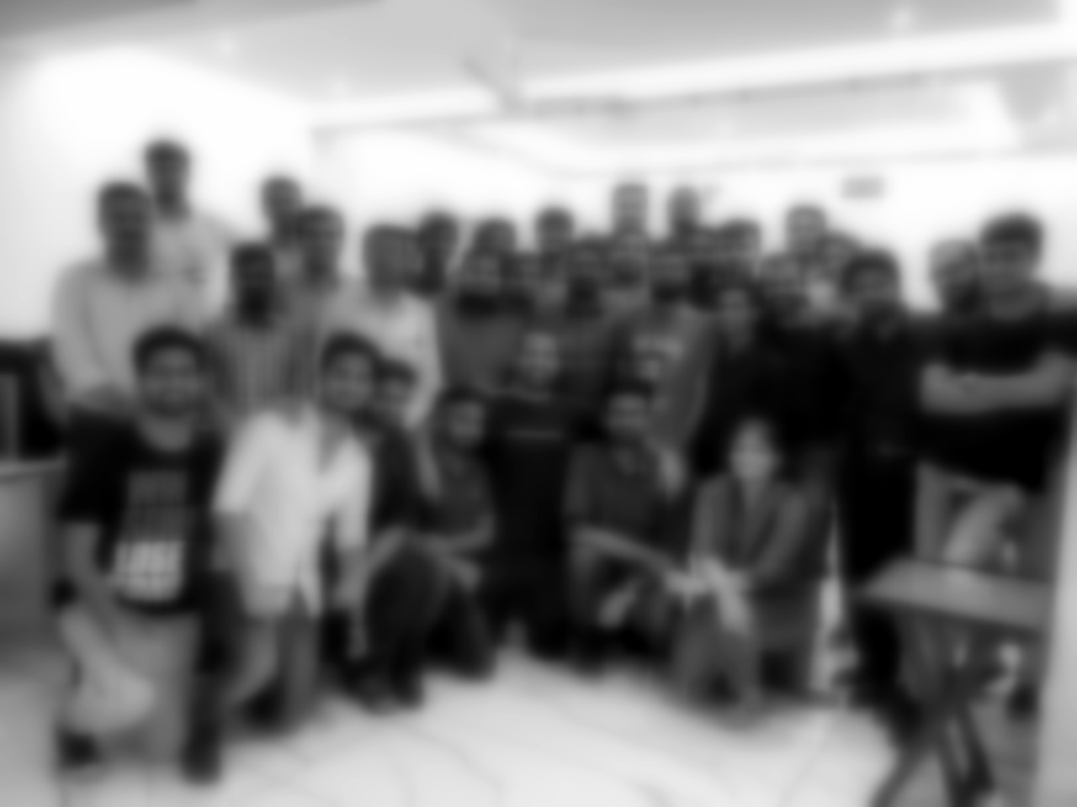


Slide 42
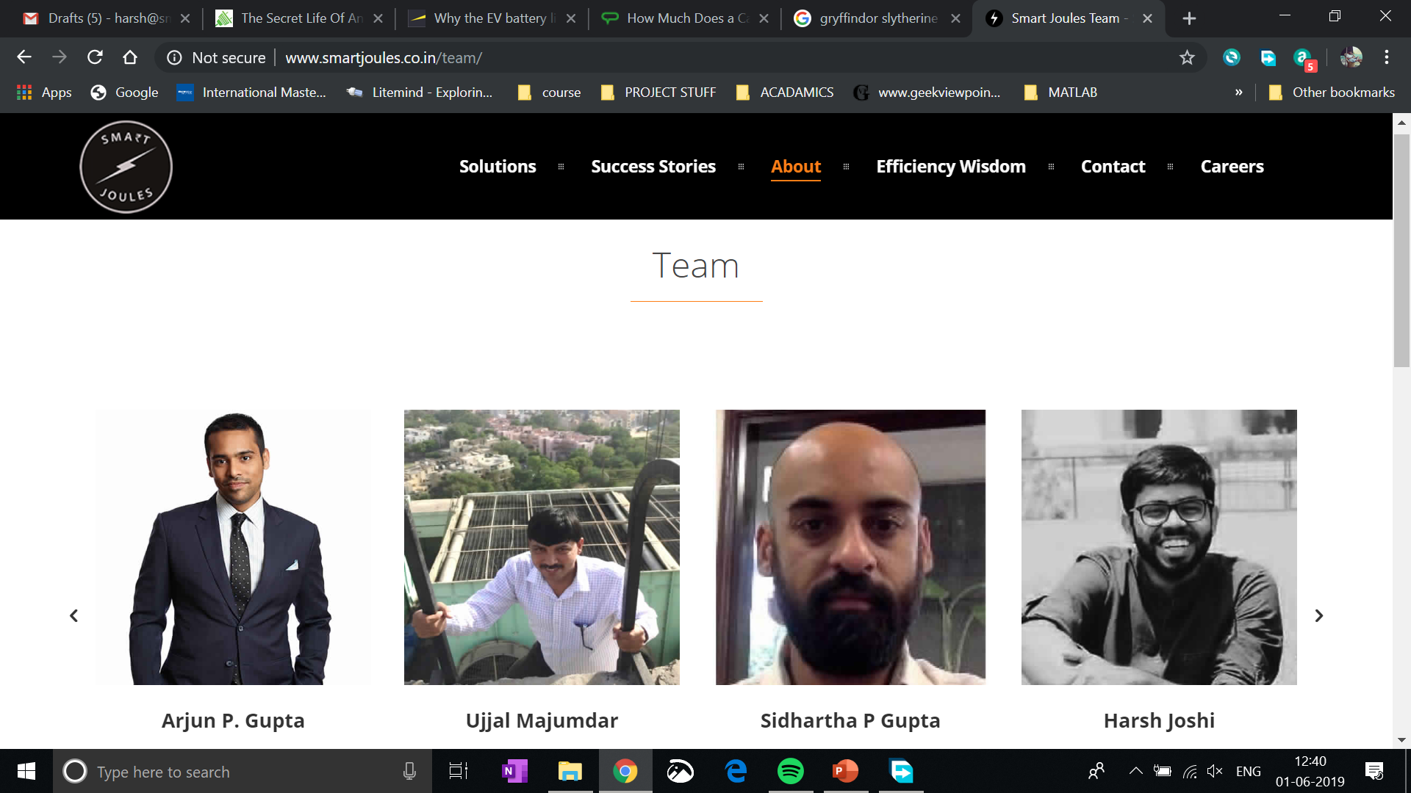
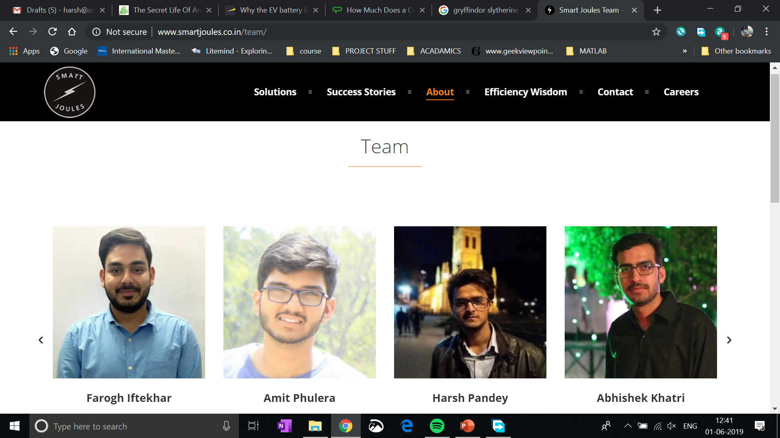

Slide 43
Gaurav
Garuddwar
It would be nice if we can make some friends along the way.
Will you help us shape a better future?.

Slide 44
Come join us, and together ….
We can create a sustainable future for this circular economy
info@smartjoules.in
www.smartjoules.co.in

